Slide 1
Canvas 绘图接口详解

Slide 2
第2章：从线条开始

Slide 3
Canvas
HTML
<canvas id=“canvas”></canvas>
Javascript
var canvas = document.getElementById(‘canvas’)
var context = canvas.getContext(‘2d’)
//使用context进行绘制

Slide 4
Draw one line
context.moveTo(100,100)
context.lineTo(700,700)
context.stroke()
状态设置
绘制

Slide 5
Draw one line
context.moveTo(100,100)
context.lineTo(700,700)
context.lineWidth = 10
context.strokeStyle = “#058”
context.stroke()
状态设置
绘制

Slide 6
Draw more lines
context.beginPath()
context.closePath()

Slide 7
Draw a Rectangle
cxt.moveTo( x , y );
cxt.lineTo( x + width , y );
cxt.lineTo( x + width , y + height );
cxt.lineTo( x , y + height );
cxt.rect( x , y , width , height );

Slide 8
Draw a Rectangle
cxt.fillRect( x , y , width , height );
cxt.strokeRect( x , y , width , height );

Slide 9
fillStyle , strokeStyle
#ffffff
#642
rgb( 255 , 128 , 0 )
rgba( 100 , 100 , 100 , 0.8 )
hsl( 20 , 62% , 28% )
hsla( 40 , 82% , 33% , 0.6 )
red

Slide 10
本章小结
HTML
<canvas id=“canvas”></canvas>
Javascript
var canvas = document.getElementById(‘canvas’)
var context = canvas.getContext(‘2d’)
//使用context进行绘制

Slide 11
本章小结
canvas.width
canvas.height
canvas.getContext(‘2d’)

Slide 12
本章小结
moveTo( x , y )
lineTo( x , y )
beginPath()
closePath()

Slide 13
本章小结
lineWidth
strokeStyle
fillStyle
stroke()
fill()

Slide 14
本章小结
rect( x , y , width , height )
fillRect( x , y , width , height )
strokeRect( x , y , width , height )

Slide 15
第3章：线条的属性

Slide 16

lineWidth

Slide 17
lineCap
butt (默认)
round
square

Slide 18

Draw a Star
x: cos(90deg) * R
y: -sin(90deg) * R
54 deg
x: cos(126deg) * r
y: -sin(126deg) * r
x: cos(54deg) * r
y: -sin(54deg) * r
18 deg
x: cos(18deg) * R
y: -sin(18deg) * R

Slide 19
lineJoin
miter (default)
bevel
round

Slide 20
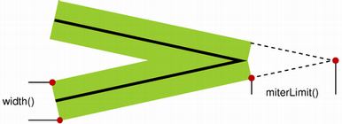
miterLimit

Slide 21
本章小结
lineWidth
lineCap = “butt” (default)
“round”
“square”

Slide 22
本章小结
lineJoin = “miter” (default)
“bevel”
“round”
miterLimit

Slide 23
第4章：星空和图形变换

Slide 24
图形变换
位移 translate( x , y )
旋转 rotate( deg )
缩放 scale( sx , sy )

Slide 25
Canvas状态的保存和恢复
save()
restore()

Slide 26
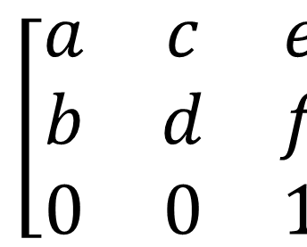
变换矩阵
a 水平缩放 ( 1 )
b 水平倾斜 ( 0 )
c 垂直倾斜 ( 0 )
d 垂直缩放 ( 1 )
e 水平位移 ( 0 )
f 垂直位移 ( 0 )

Slide 27
设置变换矩阵
transform( a , b , c , d , e , f )
setTransform( a , b , c , d , e , f )

Slide 28
本章小结
save()
restore()
translate( x , y )
rotate( deg )
scale( sx , sy )

Slide 29
本章小结
transform( a , b , c , d , e , f )
setTransform( a , b , c , d , e , f )

Slide 30
第5章：填充样式

Slide 31
fillStyle
Step 1
var grd = context.createLinearGradient(
xstart , ystart, xend , yend );
Step 2
grd.addColorStop( stop , color );

Slide 32
Radial Gradient
Step 1
var grd = context.createRadialGradient(
x0 , y0, r0 , x1 , y1 , r1 );
Step 2
grd.addColorStop( stop , color );

Slide 33
createPattern
createPattern( img , repeat-style )
repeat-style : no-repeat
repeat-x
repeat-y
repeat

Slide 34
createPattern
createPattern( canvas , repeat-style )

Slide 35
createPattern
createPattern( video , repeat-style )

Slide 36
本章小结
fillStyle = color
gradient
image
canvas
video

Slide 37
fillStyle = color
#ffffff
#642
rgb( 255 , 128 , 0 )
rgba( 100 , 100 , 100 , 0.8 )
hsl( 20 , 62% , 28% )
hsla( 40 , 82% , 33% , 0.6 )
red

Slide 38
fillStyle = gradient
Linear Gradient
var grd = context.createLinearGradient(
xstart , ystart, xend , yend );
Radial Gradient
var grd = context.createRadialGradient(
x0 , y0, r0 , x1 , y1 , r1 );
grd.addColorStop( stop , color );

Slide 39
fillStyle = image || canvas || video
createPattern( img , repeat-style )
createPattern( canvas , repeat-style )
createPattern( video , repeat-style )
repeat-style : no-repeat
repeat-x
repeat-y
repeat

Slide 40
本章小结
fillStyle = color
gradient
image
canvas
video
strokestyle

Slide 41
第6章：曲线的绘制

Slide 42
Draw an Arc
context.arc(
centerx, centery, radius,
startingAngle, endingAngle,
anticlockwise = false
)

Slide 43
Draw an Arc
1.5 pi
2 pi
1 pi
0 pi
0.5 pi

Slide 44
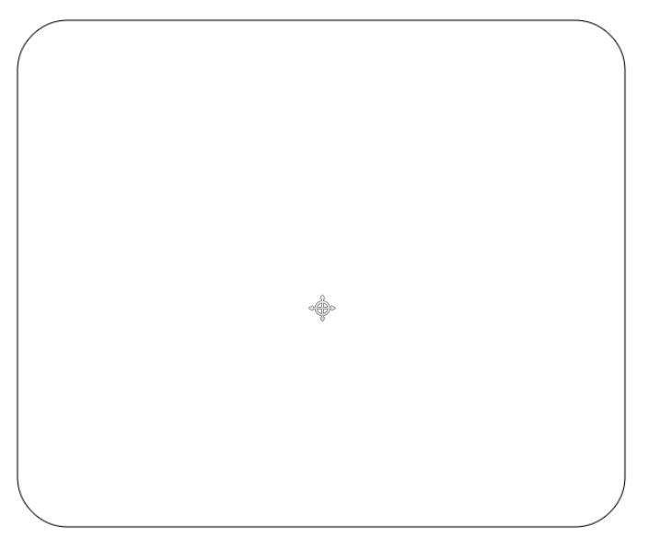
Rounded Corner Rectangle
( r , r )
( width-r , r )
( r , height - r )
( width-r , height - r )

Slide 45
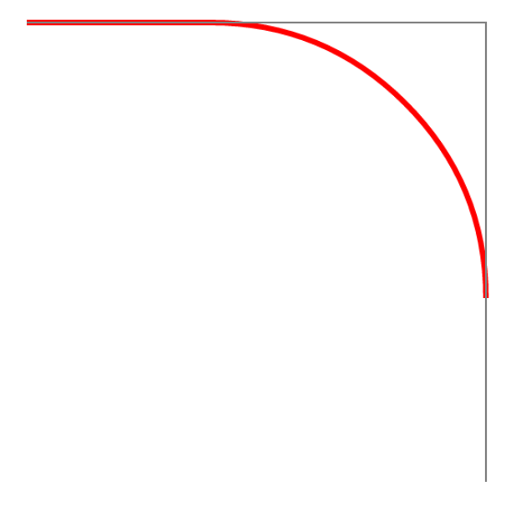
arcTo
( x0 , y0 )
( x1 , y1 )
context.arcTo(
x1 , y1 , x2 , y2 ,
radius );
( x2 , y2 )

Slide 46
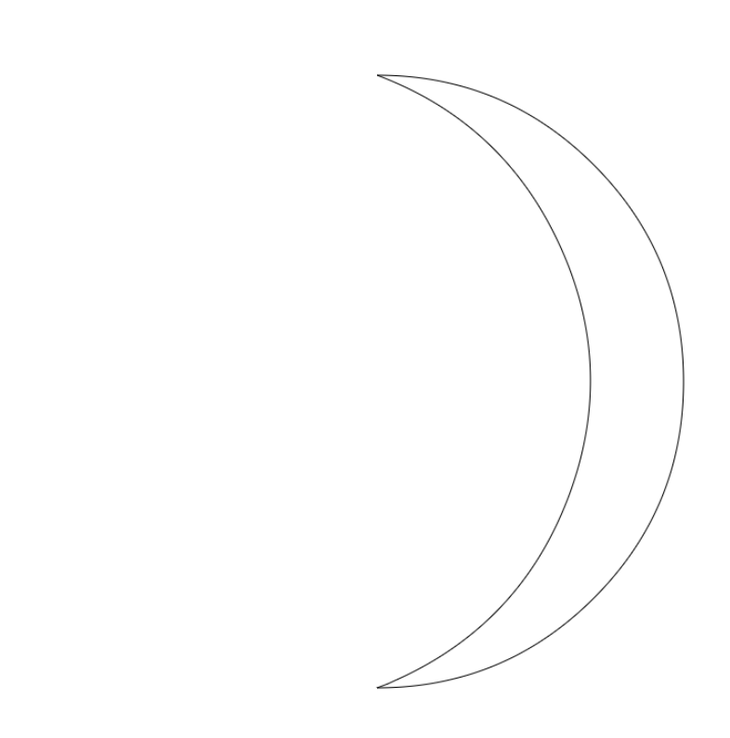
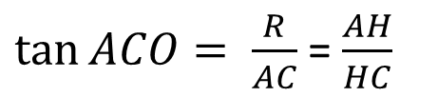
Draw a Moon
(400,100)
A
H
C
O
(400,400)
(1200,400)
B
(400,700)

Slide 47
贝塞尔曲线 Bezier

Slide 48
arcTo
context.moveTo( x0 , y0 )
context.arcTo(
x1 , y1 ,
x2 , y2 ,
radius );
开始点
控制点
结束点

Slide 49
QuadraticCurveTo
context.moveTo( x0 , y0 );
context.quadraticCurveTo(
x1, y1,
x2, y2 );
http://tinyurl.com/html5quadratic

Slide 50
BezierCurveTo
context.moveTo( x0 , y0 );
context.bezierCurveTo(
x1, y1,
x2, y2,
x3, y3 );
http://tinyurl.com/html5bezier

Slide 51
曲线的绘制
context.arc( centerx, centery, radius,
startingAngle, endingAngle,
anticlockwise = false )
context.arcTo( x1 , y1 , x2 , y2 , radius )

Slide 52
曲线的绘制
context.quadraticCurveTo(
x1, y1 ,
x2 , y2 )
context.bezeirCurveTo(
x1 , y1 , x2 , y2 ,
x3, y3 )
控制点
结束点
控制点
结束点

Slide 53
第7章：文字的渲染

Slide 54
文字渲染基础
context.font = "bold 40px Arial"
context.fillText( string , x , y , [maxlen] );
context.strokeText( string , x , y , [maxlen] );

Slide 55
font
默认值： “20px sans-serif”
context.font =
font-style font-variant font-weight
font-size font-family

Slide 56
font-style
font-style: normal ( Default )
italic ( 斜体字 )
oblique ( 倾斜字体 )

Slide 57
font-variant
font-variant: normal ( Default )
small-caps

Slide 58
font-weight
font-weight: lighter
normal ( Default )
bold
bolder
100 , 200 , 300 , 400 (normal) ,
500 , 600 , 700 (bold) ,
800 , 900

Slide 59
font-size
font-size: 20px ( Default )
2em
150%

Slide 60
font-size
font-size: xx-small
x-small
medium
large
x-large
xx-large

Slide 61
font-family
设置多种字体备选
支持 @font-face
Web安全字体

Slide 62
font
context.font =
font-style font-variant font-weight
font-size font-family

Slide 63
文本对齐
context.textAlign = left
center
right

Slide 64
文本对齐
context.textBaseline = top
middle
bottom
alphabetic (Default)
ideographic
hanging

Slide 65
文本的度量
context.measureText( string ).width

Slide 66
第8章：高级内容

Slide 67
阴影
context.shadowColor
context.shadowOffsetX
context.shadowOffsetY
context.shadowBlur

Slide 68
global
globalAlpha
globleCompositeOperation

Slide 69
globalAlpha
globalAlpha = 1 (Default)

Slide 70
globalCompositeOperation
globalCompositeOperation
= “source-over” (Default)

Slide 71
globalCompositeOperation
source-over
source-atop
source-in
source-out
destination-over
destination-atop
destination-in
destination-out
lighter
copy
xor

Slide 72
剪辑区域
context.clip()

Slide 73
交点一定在顶点？

Slide 74
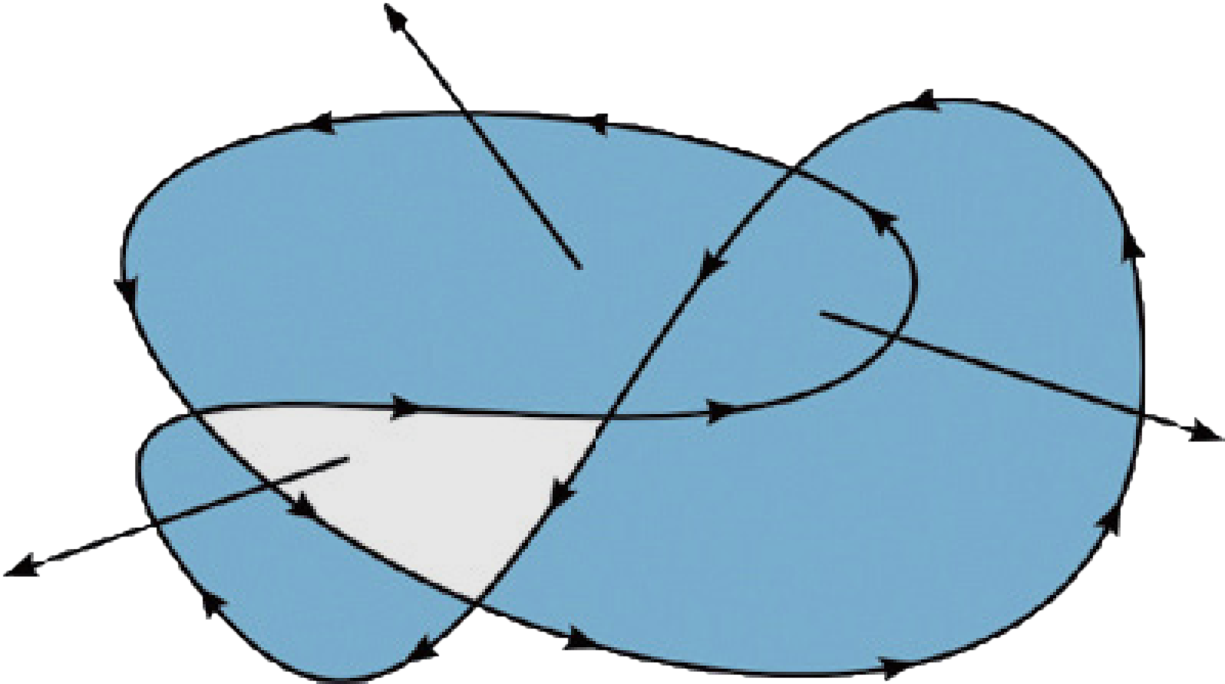
非零环绕原则

Slide 75
非零环绕原则

Slide 76
clearRect
context.clearRect( x , y , width , height )

Slide 77
isPointInPath
context.isPointInPath( x , y )

Slide 78
第9章：Canvas之旅仍在继续

Slide 79
在Canvas上使用其他控件

Slide 80
Canvas标准一直在更新

Slide 81
Canvas标准
W3C
http://www.w3.org/TR/2dcontext/
WHATWG
https://html.spec.whatwg.org/

Slide 82
Canvas与浏览器兼容

Slide 83
Canvas与IE6、7、8等浏览器的兼容性问题
explorecanvas
https://code.google.com/p/explorercanvas/

Slide 84
Canvas图形库

Slide 85
Canvas图形库
canvasplus
https://code.google.com/p/canvasplus/
Artisan JS
http://artisanjs.com/
Rgraph
https://roopons.com.au/wp-content/plugins/viral-optins/js/rgraph/

Slide 86
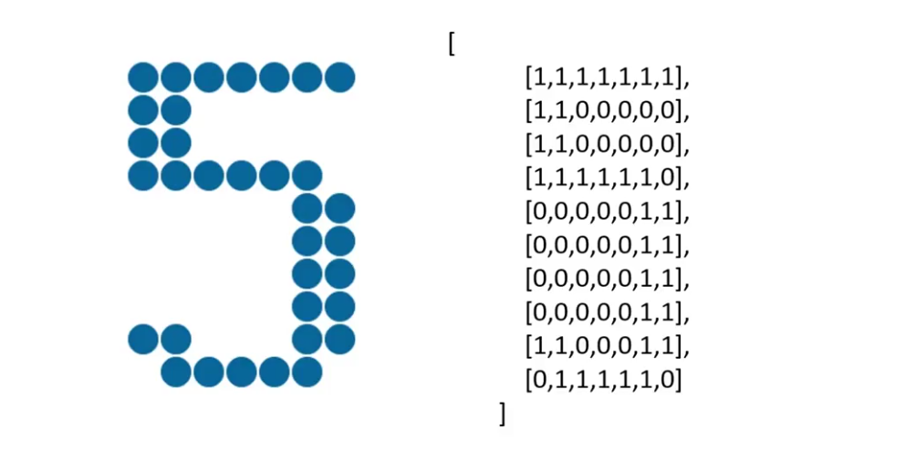
案例：点阵图

Slide 87
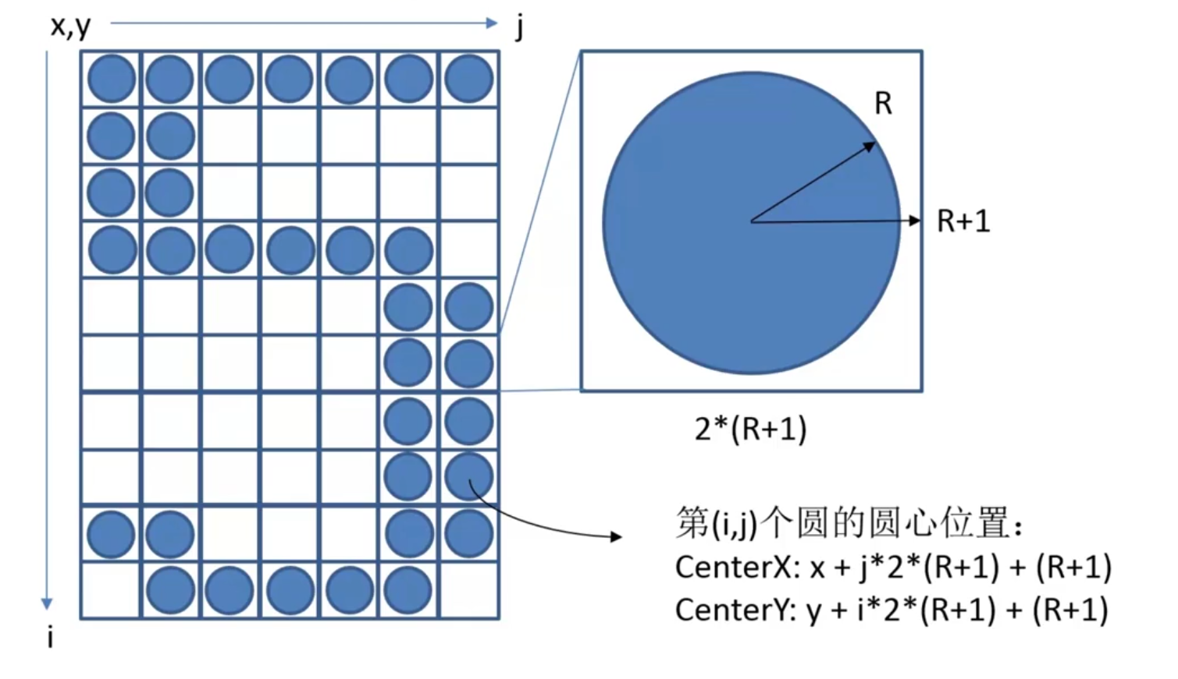
案例：点阵图计算圆的位置

